Slide 1
AWS

Slide 2
Amazon S3

Slide 3
Introduction • Amazon S3 is one of the main building blocks of AWS
• It’s advertised as ”infinitely scaling” storage
• Many websites use Amazon S3 as a backbone
• Many AWS services use Amazon S3 as an integration as well
• We’ll have a step-by-step approach to S3

Slide 4
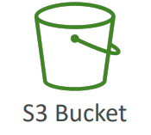
Amazon S3 – Buckets
• Amazon S3 allows people to store objects (files) in “buckets” (directories)
• Buckets must have a globally unique name (across all regions all accounts)
• Buckets are defined at the region level
• S3 looks like a global service but buckets are created in a region
• Naming convention
No uppercase, No underscore
3-63 characters long
Not an IP
Must start with lowercase letter or number
Must NOT start with the prefix xn--
Must NOT end with the suffix -s3alias S3 Bucket

Slide 5
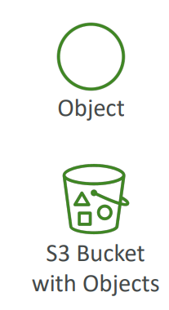
Amazon S3 – Objects
• Objects (files) have a Key
• The key is the FULL path:
s3://my-bucket/my_file.txt
s3://my-bucket/my_folder1/another_folder/my_file.txt
• The key is composed of prefix + object name
s3://my-bucket/my_folder1/another_folder/my_file.txt
• There’s no concept of “directories” within buckets
(although the UI will trick you to think otherwise)
• Just keys with very long names that contain slashes (“/”)

Slide 6
Amazon S3 – Objects (cont.)
• Object values are the content of the body:
Max. Object Size is 5TB (5000GB)
If uploading more than 5GB, must use “multi-part upload”
• Metadata (list of text key / value pairs – system or user metadata)
• Tags (Unicode key / value pair – up to 10) – useful for security / lifecycle
• Version ID (if versioning is enabled)

Slide 7
Amazon S3 – Security
• User-Based
IAM Policies – which API calls should be allowed for a specific user from IAM
• Resource-Based
Bucket Policies – bucket wide rules from the S3 console - allows cross account
Object Access Control List (ACL) – finer grain (can be disabled)
Bucket Access Control List (ACL) – less common (can be disabled)
• Note: an IAM principal can access an S3 object if
The user IAM permissions ALLOW it OR the resource policy ALLOWS it
AND there’s no explicit DENY
• Encryption: encrypt objects in Amazon S3 using encryption keys

Slide 8
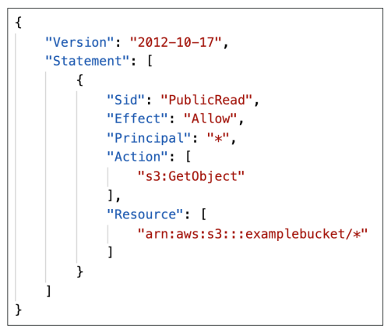
S3 Bucket Policies
• JSON based policies
• Resources: buckets and objects
• Effect: Allow / Deny
• Actions: Set of API to Allow or Deny
• Principal: The account or user to apply the policy to
• Use S3 bucket for policy to:
• Grant public access to the bucket
• Force objects to be encrypted at upload
• Grant access to another account (CrossAccount)

Slide 9
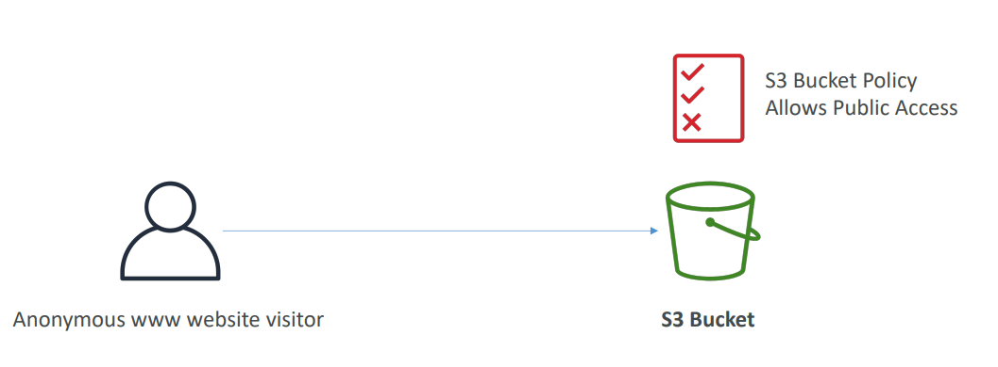
Example: Public Access - Use Bucket Policy

Slide 10
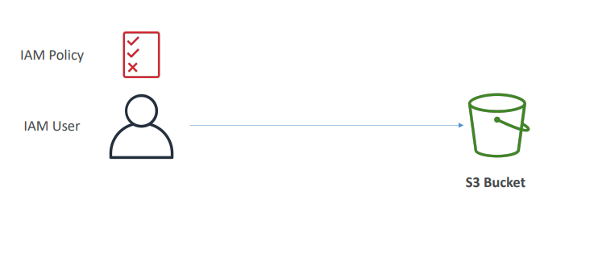
Example: User Access to S3 – IAM permissions

Slide 11
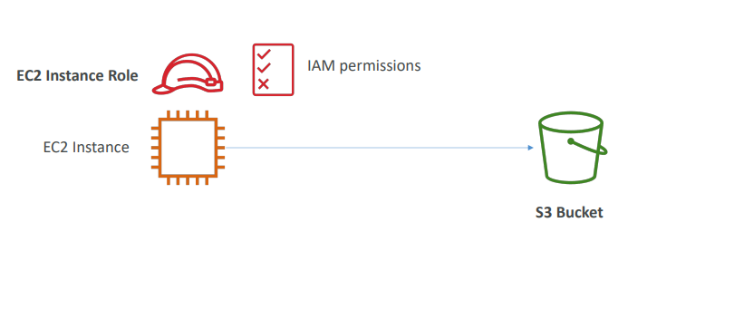
Example: EC2 instance access - Use IAM Roles

Slide 12
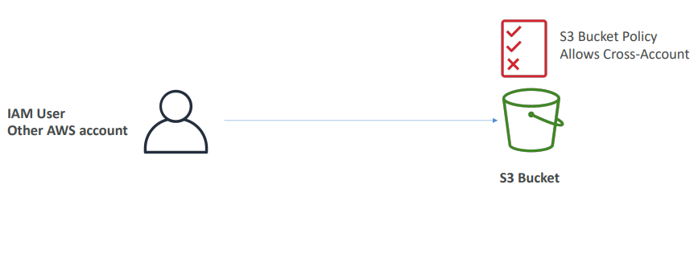
Advanced: Cross-Account Access – Use Bucket Policy

Slide 13
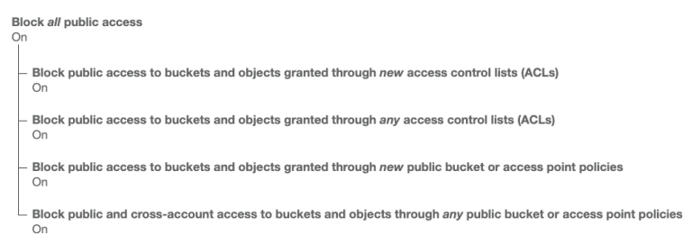
Bucket settings for Block Public Access
• These settings were created to prevent company data leaks
• If you know your bucket should never be public, leave these on
• Can be set at the account level

Slide 14
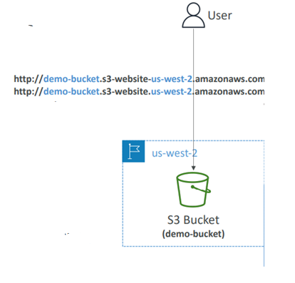
Amazon S3 – Static Website Hosting • S3 can host static websites and have them accessible on the Internet
• The website URL will be (depending on the region)
http://bucket-name.s3-website-aws-region.amazonaws.com
OR
http://bucket-name.s3-website.aws-region.amazonaws.com
• If you get a 403 Forbidden error, make sure the bucket
policy allows public reads!

Slide 15
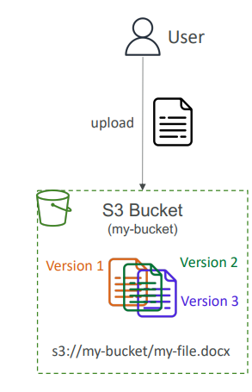
Amazon S3 –Versioning • You can version your files in Amazon S3
• It is enabled at the bucket level
• Same key overwrite will change the “version”: 1, 2, 3….
• It is best practice to version your buckets
Protect against unintended deletes (ability to restore a version)
Easy roll back to previous version
• Notes:
Any file that is not versioned prior to enabling versioning will
have version “null”
Suspending versioning does not delete the previous versions

Slide 16
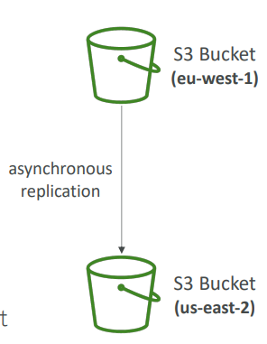
Amazon S3 – Replication (CRR & SRR)
• Must enable Versioning in source and destination buckets
• Cross-Region Replication (CRR)
• Same-Region Replication (SRR)
• Buckets can be in different AWS accounts
• Copying is asynchronous
• Must give proper IAM permissions to S3
• Use cases:
CRR – compliance, lower latency access, replication across accounts
SRR – log aggregation, live replication between production and test accounts

Slide 17
S3 Storage Classes
• Amazon S3 Standard - General Purpose
• Amazon S3 Standard-Infrequent Access (IA)
• Amazon S3 One Zone-Infrequent Access
• Amazon S3 Glacier Instant Retrieval
• Amazon S3 Glacier Flexible Retrieval
• Amazon S3 Glacier Deep Archive
• Amazon S3 Intelligent Tiering
• Can move between classes manually or using S3 Lifecycle configurations

Slide 18
S3 Durability and Availability
• Durability:
High durability (99.999999999%, 11 9’s) of objects across multiple AZ
If you store 10,000,000 objects with Amazon S3, you can on average expect to
incur a loss of a single object once every 10,000 years
Same for all storage classes
• Availability:
Measures how readily available a service is
Varies depending on storage class
Example: S3 standard has 99.99% availability = not available 53 minutes a year

Slide 19
S3 Standard – General Purpose
• 99.99% Availability
• Used for frequently accessed data
• Low latency and high throughput
• Sustain 2 concurrent facility failures
• Use Cases: Big Data analytics, mobile & gaming applications, content
distribution…

Slide 20
S3 Storage Classes – Infrequent Access
• For data that is less frequently accessed, but requires rapid access when needed
• Lower cost than S3 Standard
• Amazon S3 Standard-Infrequent Access (S3 Standard-IA)
99.9% Availability
Use cases: Disaster Recovery, backups
• Amazon S3 One Zone-Infrequent Access (S3 One Zone-IA)
High durability (99.999999999%) in a single AZ; data lost when AZ is destroyed
99.5% Availability
Use Cases: Storing secondary backup copies of on-premise data, or data you can recreate

Slide 21
Amazon S3 Glacier Storage Classes
• Low-cost object storage meant for archiving / backup
• Pricing: price for storage + object retrieval cost
• Amazon S3 Glacier Instant Retrieval
Millisecond retrieval, great for data accessed once a quarter
Minimum storage duration of 90 days
• Amazon S3 Glacier Flexible Retrieval (formerly Amazon S3 Glacier):
Expedited (1 to 5 minutes), Standard (3 to 5 hours), Bulk (5 to 12 hours) – free
Minimum storage duration of 90 days
• Amazon S3 Glacier Deep Archive – for long term storage:
Standard (12 hours), Bulk (48 hours)
Minimum storage duration of 180 days

Slide 22
S3 Intelligent-Tiering
• Small monthly monitoring and auto-tiering fee
• Moves objects automatically between Access Tiers based on usage
• There are no retrieval charges in S3 Intelligent-Tiering
• Frequent Access tier (automatic): default tier
• Infrequent Access tier (automatic): objects not accessed for 30 days
• Archive Instant Access tier (automatic): objects not accessed for 90 days
• Archive Access tier (optional): configurable from 90 days to 700+ days
• Deep Archive Access tier (optional): config. from 180 days to 700+ days

Slide 23
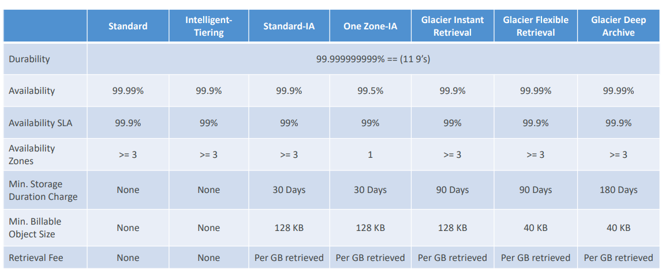
S3 Storage Classes Comparison
https://aws.amazon.com/s3/storage-classes/

Slide 24
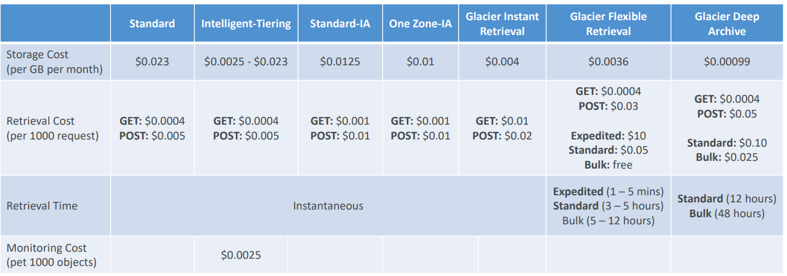
S3 Storage Classes – Price Comparison Example: us-east-1
https://aws.amazon.com/s3/pricing/

Slide 25
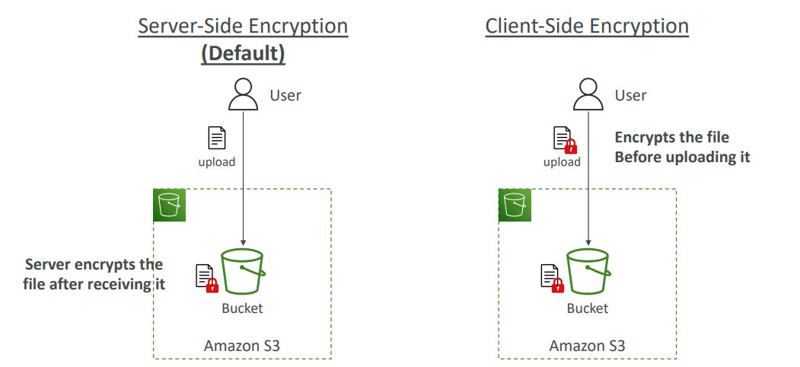
S3 Encryption

Slide 26
Amazon S3 – Object Encryption
• You can encrypt objects in S3 buckets using one of 4 methods
• Server-Side Encryption (SSE)
Server-Side Encryption with Amazon S3-Managed Keys (SSE-S3) – Enabled by Default
Encrypts S3 objects using keys handled, managed, and owned by AWS
Server-Side Encryption with KMS Keys stored in AWS KMS (SSE-KMS)
Leverage AWS Key Management Service (AWS KMS) to manage encryption keys
Server-Side Encryption with Customer-Provided Keys (SSE-C)
When you want to manage your own encryption keys
• Client-Side Encryption

Slide 27
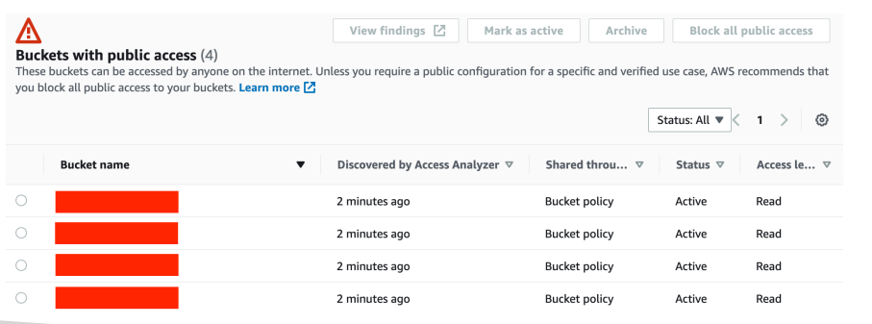
IAM Access Analyzer for S3
• Ensures that only intended people have access to your S3 buckets
• Example: publicly accessible bucket, bucket shared with other AWS account…
• Evaluates S3 Bucket Policies, S3 ACLs, S3 Access Point Policies
• Powered by IAM Access Analyzer

